Slide 1
Project: Helpdesk-Tickets
- Roadmap
Done?



Step 0) Make another meeting without me to build the roadmap
Talk about your experiences, which tools you are familiar with, your vision for this project.
Try to find some similar projects on Github, Kaggle... to help you building the roadmap.
Write a first iteration roadmap and split tasks between each other.

Slide 2
Project: Helpdesk-Tickets
- Roadmap
Done?





Step 1) Data mining + DataViz’: Deadline Friday, December 19th
Your first task will be to define the context and the scope of the project: I expect you to really take the time to understand the project and to learn as much as possible about the concepts it will introduce.
You will then have to take in hand and discover your dataset and make an almost exhaustive analysis of it in order to highlight the structure, the difficulties and possible biases of the dataset.
I will also expect at least 5 graphical representations built from your dataset, visual and especially relevant. For each of them I will expect:
A precise commentary, which analyses the figure and provides a “business” opinion.
A validation of the observation by data manipulation or a statistical test. (????, Corr, Data types, groupby, assignees)

Slide 3
Project: Helpdesk-Tickets
- Roadmap
Done?


Step 2) Pre-processing and feature engineering : Deadline Friday, January 19th
Following the observations made in the previous step, you will have to clean your dataset and perform the pre-processing steps.
If necessary, you will have to transform and/or add features and enrich your dataset.
The objective at the end of this step is to have a dataset ready to perform in-depth analysis and/or modeling using Machine (and Deep) Learning.
Rendering 1: data exploration, data visualization and pre-processing report. After rendering 1, if not already done, I will instantiate a GitHub repo for your group, which will have to respect the template provided and be sent to the jury with the final report.

Slide 4
Project: Helpdesk-Tickets
- Roadmap
Done?



Step 3) Modeling :
Step 1 : Deadline Friday, January 30th
Elaboration of the first modeling iterations with baseline models.
Analyze your first results, is your approach relevant? And your model?
Step 2 : Deadline Friday, February 06th
Use Machine Learning and statistical metrics to better understand the results of your model.
Optimization: Try to improve your model with optimization tools, you can try other more complex models and compare the results.
Step 3 : Deadline Friday, February 13th
Advanced modeling: Use bagging/boosting and Deep Learning techniques.
Interpretation: Use the interpretability tools to better understand the results of your models.
Scientific and business conclusions based on the success or failure of the modeling.

Slide 5
Project: Helpdesk-Tickets
- Roadmap
Done?


Rendering 2: Modeling report
Step 5) Final report + codes on GitHub : Deadline Friday, February 13th
You will submit the final report: made up of the first two renderings, it concretizes your vision and your work on your project by integrating a conclusion and an opening.
You also turn in your clean and commented code on GitHub, if time allows you will be able to refine your model and modeling pipeline during this step.
Step 6) Streamlit + Defense: Monday, February 23th ( to be confirmed )
The document Defense_Methodology summarizes the defense’s organization. The presentation will be as follows:
20 minutes of presentation
10 minutes of questions from the jury members
You have the possibility to make either :
Powerpoint presentation + Streamlit demo
The entire presentation with your Streamlit application
Your application will have to :
be aesthetically pleasing, with several tabs
carefully coded, without re-training your model
works without bugs.

Slide 6
Project: Helpdesk-Tickets
- Step 0
 Talk about your experiences, which tools you are familiar with, your vision for this project
 Try to find some similar projects on Github, Kaggle... to help you building the roadmap.
https://github.com/s4sahiko/Smart-Ticket-Classifier-3.0
https://github.com/sukhijapiyush/NLP-Case-Study---Automatic-Ticket-Classification

Slide 7
Project: Helpdesk-Tickets
- Step 0
 Write a first iteration roadmap and split tasks between each other.
Marina
Checking distribution & visualize
Exclude workflow variables
Checking of Chronogical order
Exploring datas & readme
Checking of dubplicates
Checking of dubplicates
extracting columns names
& size & types
Exploring datas & readme
Checking of primary keys of
all df to join
Transfer to the right types
Checking of missing values
Correlation of numeric variables
Bottleneck analysis
Correlation heatmap of numeric var
Correlation of all variables
Correlation heatmap of all var
Chris

Slide 8
Project: Helpdesk-Tickets
- Step 1
 Define the context and the scope of the project
Overall Objective
Reduction of throughput times
Improving the quality of our service
Better experience for our customers
Cost reduction
Margin improvement
Inclusions
Time analysis (priority, type, project, etc.)
Assignees analysis (training needs)
Performance analysis (strengths and weakness of employees)
Process analysis (better work instructions)
Communication analysis (influence of comments)

Slide 9
Project: Helpdesk-Tickets
- Step 1
 Discover your dataset and make an almost exhaustive analysis
Given data’s:
issues.csv (data reduction of issues_snapshot.csv, except total time for a ticket)
issues_snapshot.csv
issues_change_history.csv (timestamps of status change)
issues_utterances.csv (comments)
issues_snapshot_sample (scoring of assignees)
The files can all be linked using a primary key.
Data in the respective files was examined and checked for errors and empty cells. Some empty cells were filled. Furthermore, the data types were corrected.
To test the dependencies of the variables, the data was examined for correlation (numerical and categorical). Heat maps were then created.
The data was examined for distribution and presented in diagrams.

Slide 10
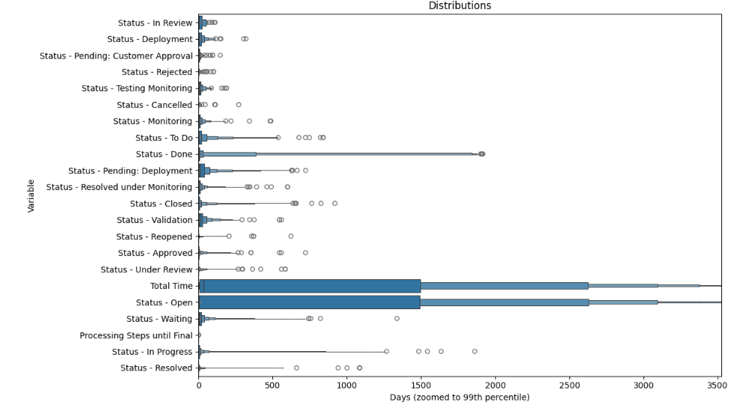
Project: Helpdesk-Tickets
- Step 1
 Discover your dataset and make an almost exhaustive analysis
Diagramm 1)

Slide 11
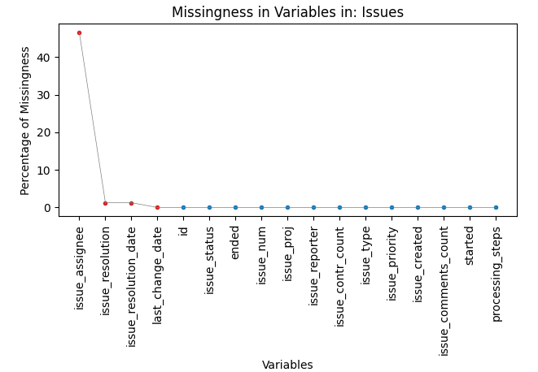
Project: Helpdesk-Tickets
- Step 1
 Discover your dataset and make an almost exhaustive analysis
Diagramm 2)

Slide 12
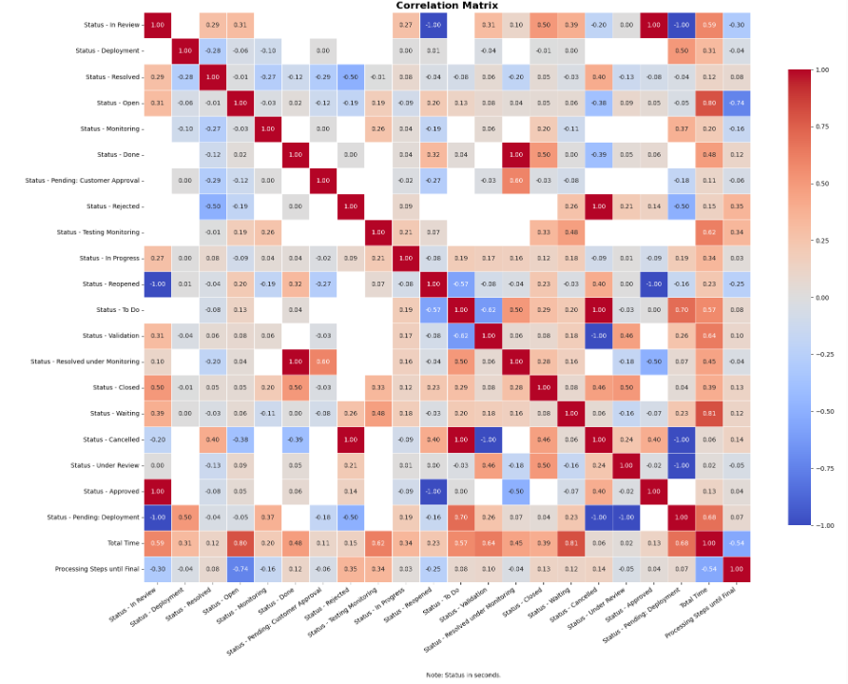
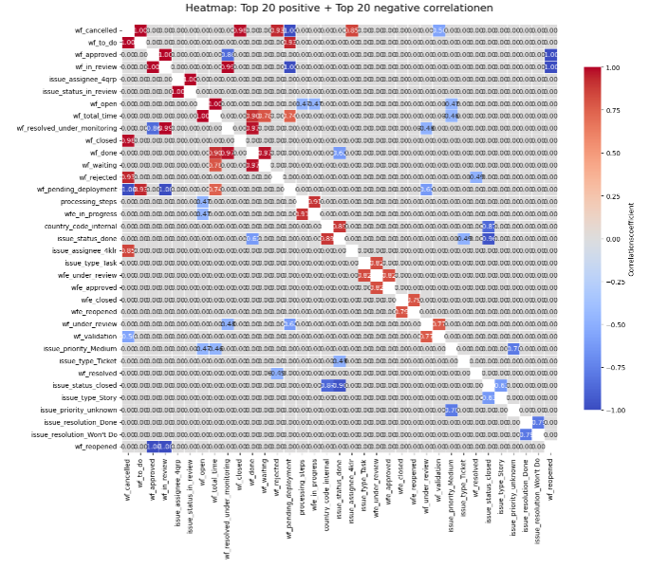
Project: Helpdesk-Tickets
- Step 1
 Discover your dataset and make an almost exhaustive analysis
Diagramm 3) Diagramm 4)

Slide 13
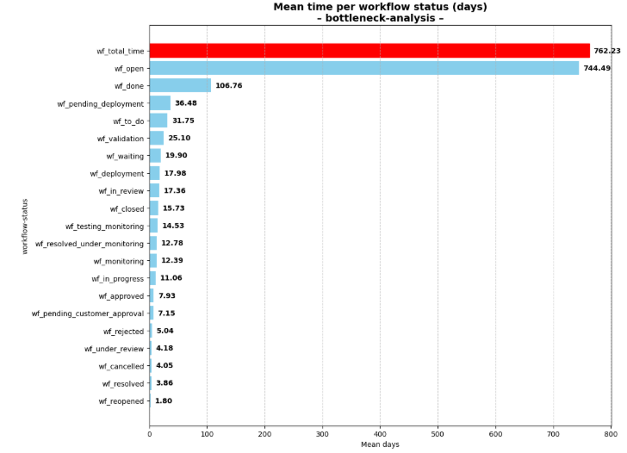
Project: Helpdesk-Tickets
- Step 1
 Discover your dataset and make an almost exhaustive analysis
Diagramm 5)

Slide 14
Project: Helpdesk-Tickets
- Step 1
 A precise commentary, which analyses the figure and provides a “business” opinion
There are many outliers; it is possible that work processes are not being followed correctly or are not described correctly.
Apparently, work assignments are often not assigned.
On average, a ticket takes two years to be closed!?
Conculsion:
All this is possible:
Reduction of throughput times
Improving the quality of our service
Better experience for our customers
Cost reduction
Margin improvement

